Slide 1
Modernizing Risk and Return Analysis with Machine Learning
Kubra , Joash, Aman , Manasa
Professor Yue Gao
15th April 2025

Slide 2
01
Introduction

Slide 3
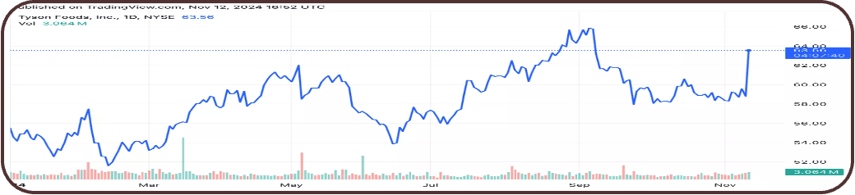
What is stock market ?
Buying and Selling of share of a company
Stock market is like a heartbeat of a company
Trade war impact on global economy
Notes:
Bullet point – background information – background stock market in us : nvdia background

Slide 4
Problem Statement
-Can machine learning outperform conventional financial models in return prediction?
-How do ML models compare in terms of interpretability and accuracy?
-Is there a trade-off between model complexity and predictive performance?
Notes:
Font size bigger -20

Slide 5

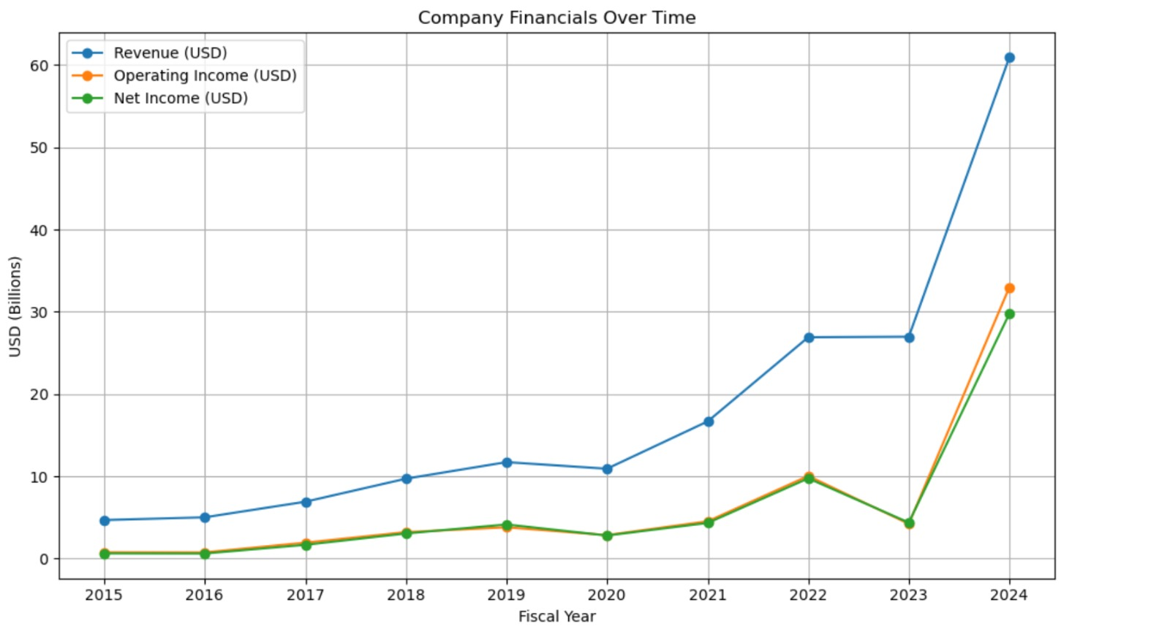
Graphics processing and artificial intelligence (AI)
GPU Development, CUDA Platform, AI Leadership
Nvidia achieved a market capitalization of $3.45 trillion
Revenue of $39.3 billion and a net income of $22.1 billion.

Slide 6
Why NVIDIA ?
Explosive Growth & Volatility = Rich Data
AI and Tech Sector Representation
Investor Attention and Media Coverage
Strong Financials = Rich Feature Space
Macro Impact and Sector Leadership
Public Data Availability

Slide 7
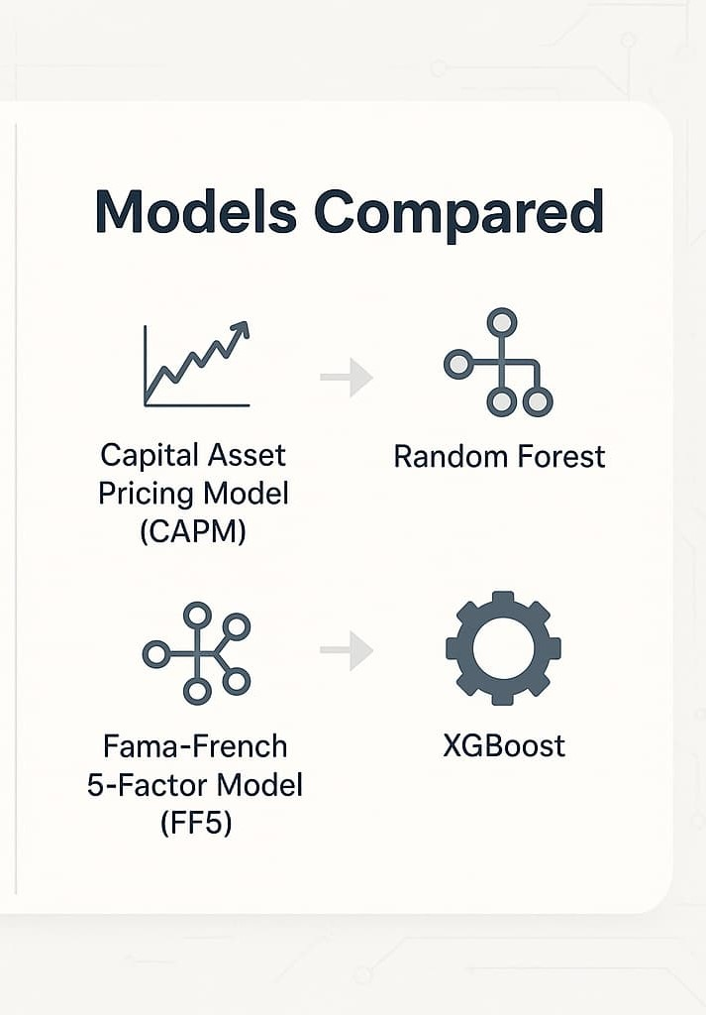
Objective
Investigate whether machine learning (ML) models outperform traditional financial models in predicting Nvidia’s stock returns.
Models Compared:
Capital Asset Pricing Model (CAPM)
Fama-French 5-Factor Model (FF5)
Machine Learning Models: Random Forest, XGBoost

Slide 8

Why this comparison?
CAPM and FF5 are canonical models in financial economics.
There is growing interest in ML for financial forecasting.
Nvidia represents a volatile, tech-driven stock, suitable for testing predictive power.
Notes:
Advanced ML

Slide 9
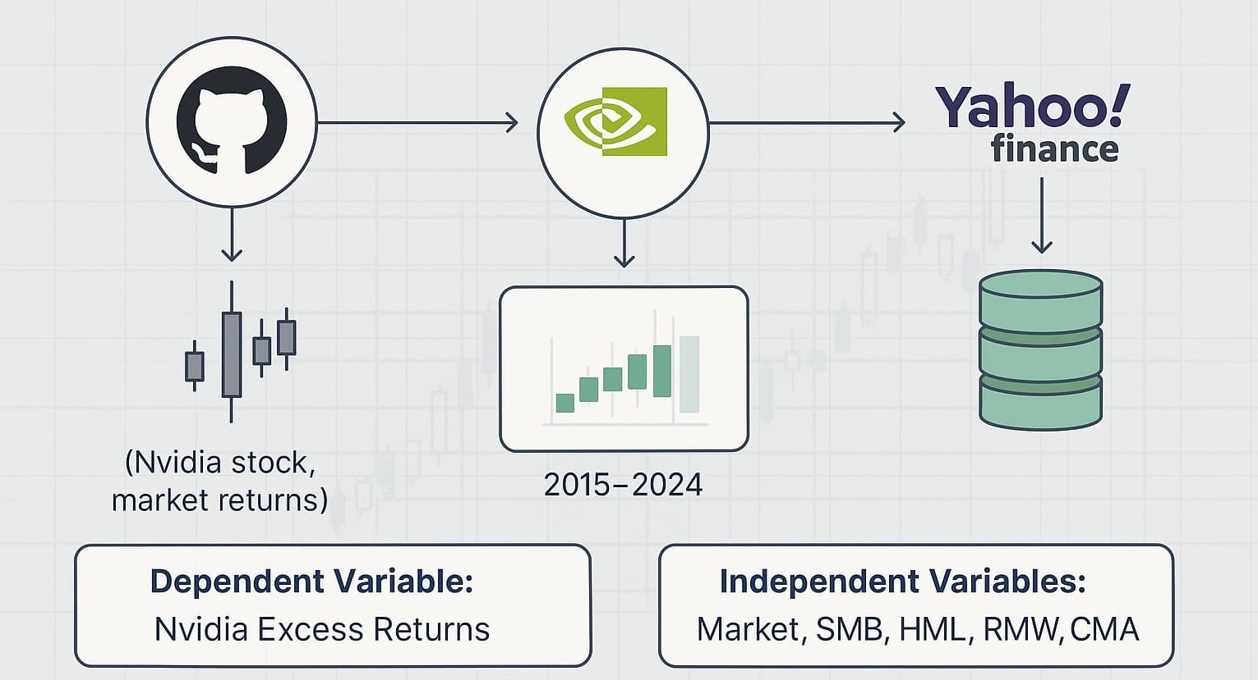
Data Collection
Notes:
Sample period , sample size and data frequency. Mean and summary statistics as well.

Slide 10
Data Collection
Time Period:
Variables Used:
Independent Variables:
Market excess return
SMB, HML, RMW, CMA (Fama-French factors)
Frequency : Daily Data
Sample size : 2513 days
From 2015 to 2024
Dependent Variable: Nvidia’s excess stock returns
Notes:
NEW SLIDE – WITH Variable and abbrevations

Slide 11
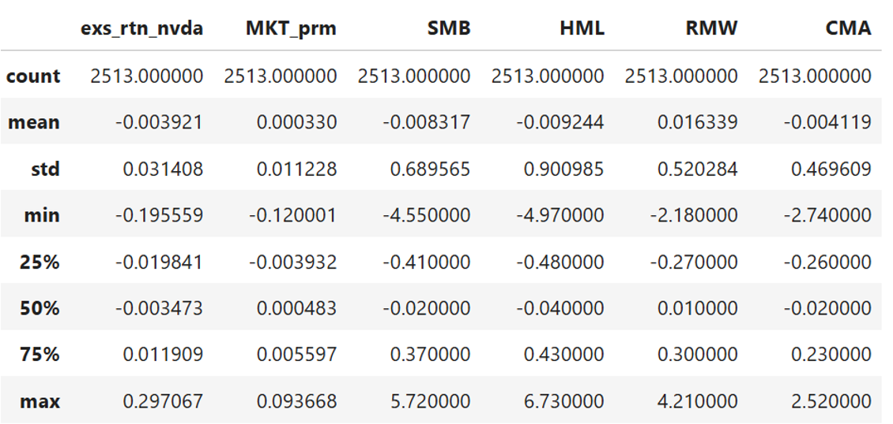
Data Description

Slide 12
Data
CAPM
exs_rtn_nvda (y) | Excess Return of Nvidia — This is Nvidia’s actual return minus the risk-free rate. It shows how much return Nvidia generated above a “safe” investment. It’s your target (y) in regression.
Mkt_prm(X) | Market Risk Premium — This is the return of the overall market (usually something like the S&P 500) minus the risk-free rate. It measures how much extra return the market offered over a risk-free investment. It’s your main feature in CAPM.
Fama French 5 Factor Model
exs_rtn_nvda (y) | Excess Return of Nvidia — This is Nvidia’s actual return minus the risk-free rate. It shows how much return Nvidia generated above a “safe” investment. It’s your target (y) in regression.
MKT_prm | Market Risk Premium — This is the return of the overall market (usually something like the S&P 500) minus the risk-free rate. It measures how much extra return the market offered over a risk-free investment. It’s your main feature in CAPM.
SMB | Measures the size premium: the excess returns of small-cap stocks over big-cap stocks.
HML | Measures the value premium: the excess returns of high book-to-market (value) stocks over low book-to-market (growth) stocks.
RMW | Measures the profitability factor: the excess returns of firms with robust profitability over those with weak profitability.
CMA | Aggressive Measures the investment factor: the excess returns of firms that invest conservatively over those that invest aggressively.

Slide 13
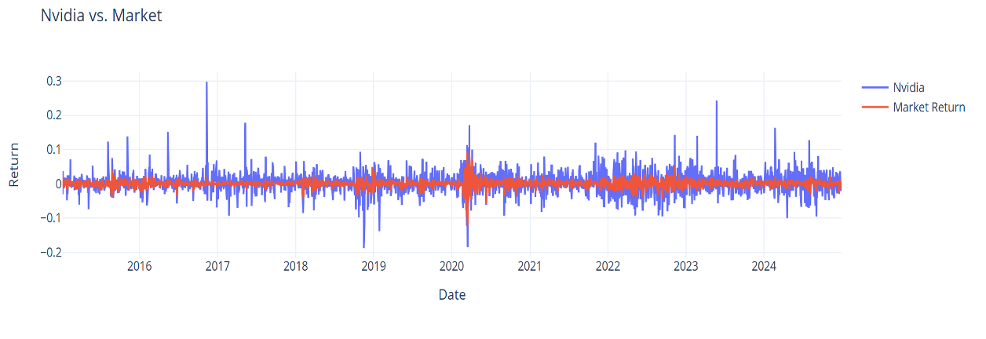
Return Comparison

Slide 14
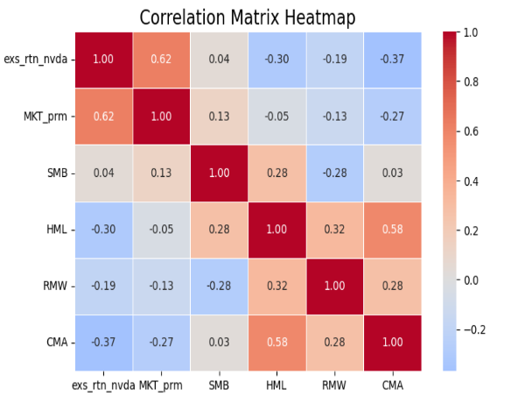
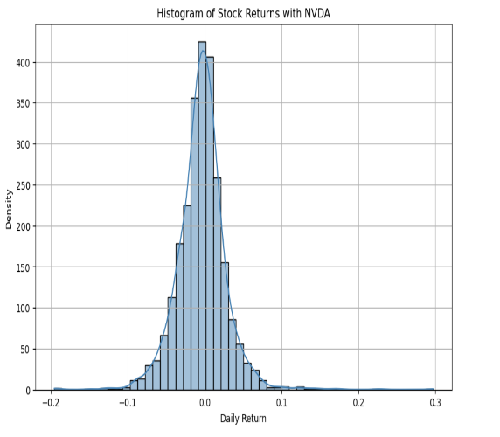
EDA

Slide 15
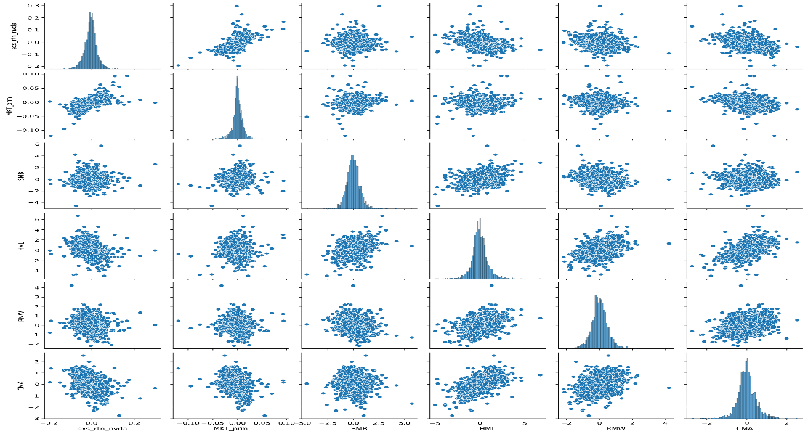
How variables are related to each other

Slide 16
Methods
02

Slide 17
Advanced Machine Learning Models
Random Forest
XGBoost
Training Approach:
Used the same features as traditional models
Hyperparameter tuning was conducted
Polynomial regression explored for additional nonlinear relationships
Notes:
Right after data :- Add discriptive statistics – correlation co-efficient (heat map or correlation matrix )

Slide 18
Traditional Models
CAPM :
Fama-French 5-Factor Model:
Model Implementation:
Both models are estimated using linear regression techniques.

Slide 19
Evaluation Metrics:
R²
Adjusted R²
Mean Squared Error (MSE)
Root Mean Squared Error (RMSE)

Slide 20
Results
Advanced Machine Learning Models
Performance Observations:
-Both Random Forest and XGBoost showed lower R² and higher RMSE
-Evidence of overfitting and poor generalization
-Polynomial regression provided only minor improvements
Possible Causes:
-Small dataset (not ideal for data-hungry Advanced ML models)
-Limited non-linear relationships captured by features

Slide 21
Results
Traditional Models – CAPM vs FF5
Fama-French Outperforms CAPM:
-Higher Adjusted R²
-Lower RMSE
-Better at capturing multidimensional risk

Slide 22
Results
MODELS | CAPM |  |  | Fama French
METRICS | MSE | RMSE | Adjusted R2 | MSE | RMSE | Adjusted R2
Regression Model | 0.00056 | 0.023619 | 0.40469 | 0.00053 | 0.02302 | 0.46167
XGBoost | 0.00068 | 0.02600 | 0.32770 | 0.00087 | 0.02942 | 0.14205
Random Forest | 0.00087 | 0.02951 | 0.13406 | 0.00088 | 0.13623 | 0.12754

Slide 23
Key Takeaways
Fama-French 5-Factor model outperformed both CAPM and Advanced ML models
Advanced ML models underperformed under current constraints
Simpler models still retain practical value in finance
Notes:
Generate feature importance plot , performance accuracy or matrix , which model performed best , which variables are more important in predicting variables , which moel is good

Slide 24

Interpretation of Results
-FF5 remains a robust, interpretable model for financial return prediction
-Advanced ML models may require larger datasets or alternative features (macroeconomic indicators, sentiment scores)
-FF5’s strength lies in economic intuition and parsimony
Notes:
Performance matrix :- random forest and xg boost , predictive analysis, table of performance model. Test mse . Ff5 – test mse , random forest. Adjusted r square , table , for each column matrix – table – which model performed the best. Provide specific number.

Slide 25
Our Conclusions
-Fama-French and CAPM are still helpful for financial intuition.
-Some prediction power is provided by Random Forest and XGBoost.
-Comprehending both models improves financial judgment.
-Future research should incorporate macroeconomic factors and Sentiment analysis.
Notes:
Report results : capm – ff5

Slide 26

Thank You

